Slide 1

iOS Programming John Crowson & Chris Longe

Slide 2
Agenda
The Swift programming language
Quiz
Build notes app using Xcode
Pair programming!
Notes:
Who has worked with Swift before?
Use for all four platforms
Objective C – can have hybrid codebase

Slide 3
Swift is a new programming language for iOS, macOS, watchOS, and tvOS app development.
Notes:
Who has worked with Swift before?
Use for all four platforms
Objective C – can have hybrid codebase

Slide 4
Swift Evolution
Jun 2014
Sep 2014
Jun 2015
Dec 2015
Sep 2016
Late 2017
beta
1.0
2.0
open-sourced
3.0
4.0
Notes:
Approaching the three year mark with Swift
Remarkable how quickly become One of ten most popular programming language despite how new it is and the ongoing rapid changes as compared to other language
TIOBE
Fast evolving not great for stack overflow.

Slide 5
Getting our feet wet with Swift: Xcode -> “Get started with a new playground”
Notes:
Is not intended to be comprehensive, just get you warmed up with some of the more common concepts

Slide 6
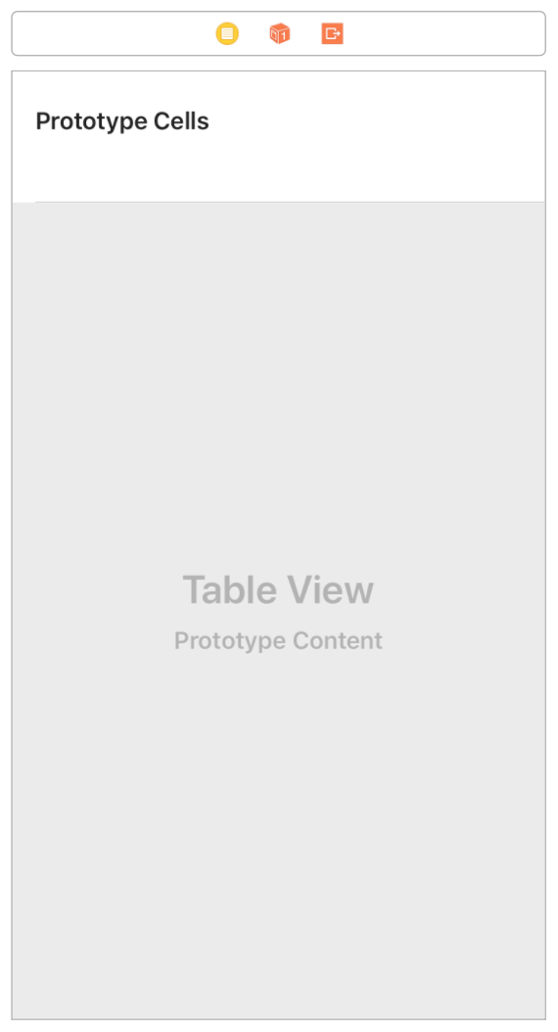
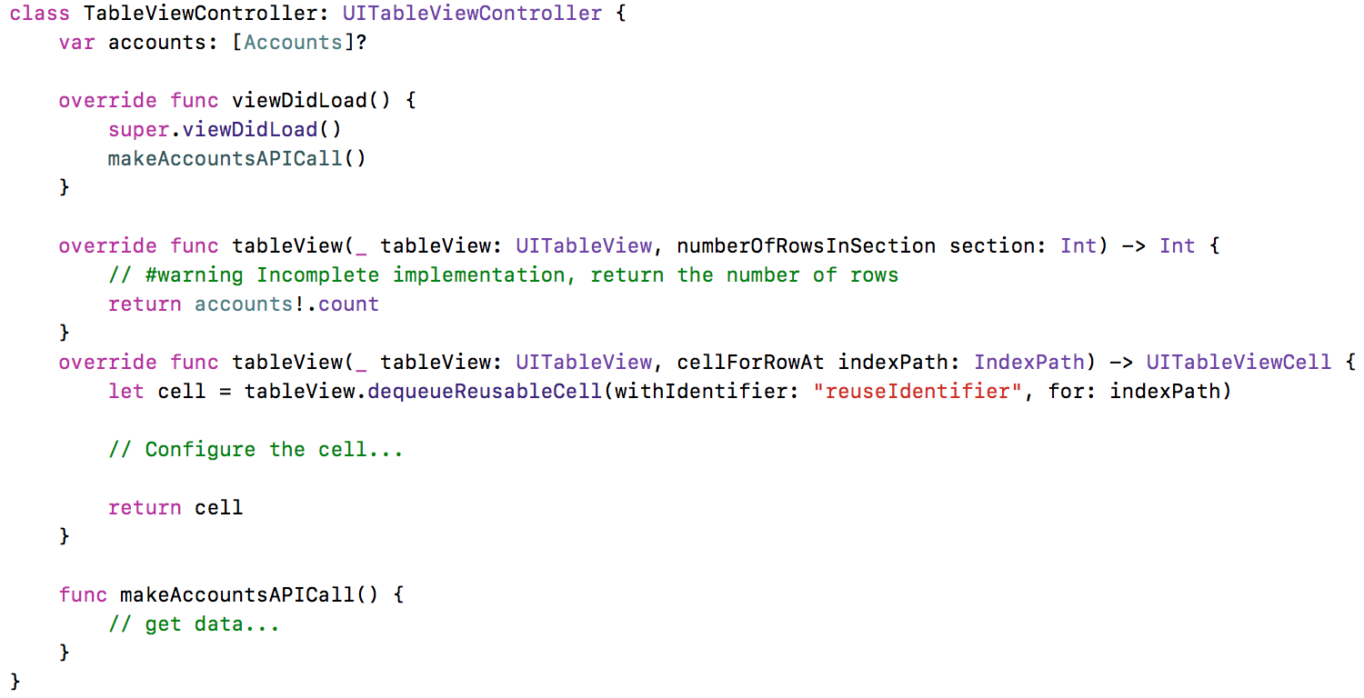
UITableViewController method
UITableViewController method
UITableViewController method

